Slide 1
CSE 506:
Operating Systems
Networking & NFS

Slide 2
4 to 7 layer diagram

Slide 3
TCP/IP Reality
The OSI model is great for undergrad courses
TCP/IP (or UDP) is what the majority of world uses

Slide 4
Ethernet (or 802.2 or 802.3)
LAN (Local Area Network) connection
Simple packet layout:
  Header
    type
    source MAC address
    destination MAC address
    length (up to 1500 bytes regular, up to 9000 bytes “jumbo”)
    …
  Data block (payload)
  Checksum
Higher-level protocols “nested” inside payload
“Unreliable” – no guarantee packet will be delivered

Slide 5
Ethernet Details
Each device listens to all traffic
  Hardware filters out traffic intended for other hosts
    i.e., different destination MAC address
  Can be put in “promiscuous” mode
    Accept everything, even if destination MAC is not own
If multiple devices talk at the same time
  Hardware automatically retries after a random delay

Slide 6
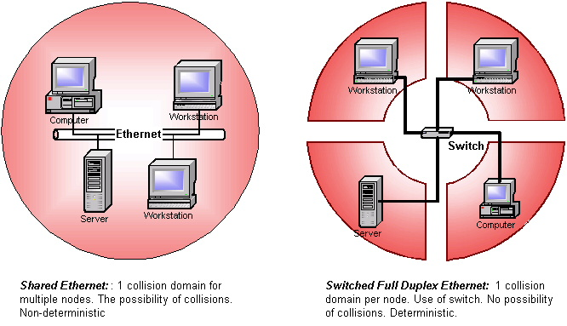
Shared vs Switched
Source: http://www.industrialethernetu.com/courses/401_3.htm

Slide 7
Switched Networks
Modern Ethernets are point-to-point and switched
What is a hub vs. a switch?
  Both are boxes that link multiple computers together
  Hubs broadcast to all plugged-in computers
    Let NICs figure out what to pass to host
      Promiscuous mode sees everyone’s traffic
  Switches track who is plugged in
    Only send to expected recipient
      Makes sniffing harder ☹

Slide 8
Internet Protocol (IP)
2 flavors: Version 4 and 6
  Version 4 widely used in practice
  Version 6 should be used in practice – but isn’t
    Public IPv4 address space is practically exhausted (see arin.net)
Provides a network-wide unique address (IP address)
  Along with netmask
  Netmask determines if IP is on local LAN or not
If destination not on local LAN
  Packet sent to LAN’s gateway
  At each gateway, payload sent to next hop

Slide 9
Address Resolution Protocol (ARP)
IPs are logical (set in OS with ifconfig or ipconfig)
OS needs to know where (physically) to send packet
  And switch needs to know which port to send it to
Each NIC has a MAC (Media Access Control) address
  “physical” address of the NIC
OS needs to translate IP to MAC to send
  Broadcast “who has 10.22.17.20?” on the LAN
  Whoever responds is the physical location
    Machines can cheat (spoof) addresses by responding
  ARP responses cached to avoid lookup for each packet

Slide 10
User Datagram Protocol (UDP)
Simple protocol for communication
  Send packet, receive packet
  No association between packets in underlying protocol
    Application is responsible for dealing with…
      Packet ordering
      Lost packets
      Corruption of content
      Flow control
      Congestion
Applications on a host are assigned a port number
  A simple integer
  Multiplexes many applications on one device
  Ports below 1k reserved for privileged applications

Slide 11
Transmission Control Protocol (TCP)
Higher-level protocol layers end-to-end reliability
  Transparent to applications
  Lots of features
    packet acks, sequence numbers, automatic retry, etc.
  Pretty complicated
Same port abstraction (1-64k)
  But different ports
  i.e., TCP port 22 isn’t the same port as UDP port 22

Slide 12
Web Request Example

Slide 13
Networking APIs
Programmers rarely create Ethernet frames
Most applications use the socket abstraction
  Stream of messages or bytes between two applications
  Applications specify protocol (TCP or UDP), remote IP
bind()/listen(): waits for incoming connection
connect()/accept(): connect to remote end
send()/recv(): send and receive data
  All headers are added/stripped by OS

Slide 14
Linux implementation
Sockets implemented in the kernel
  So are TCP, UDP, and IP
Benefits:
  Application not involved in TCP ACKs, retransmit, etc.
    If TCP is implemented in library, app wakes up for timers
  Kernel trusted with correct delivery of packets
A single system call:
  sys_socketcall(call, args)
    Has a sub-table of calls, like bind, connect, etc.

Slide 15
Linux Plumbing
Each message is put in a sk_buff structure
  Passed through a stack of protocol handlers
  Handlers update bookkeeping, wrap headers, etc.
At the bottom is the device itself (e.g., NIC driver)
  Sends/receives packets on the wire

Slide 16
sk_buff

Slide 17
Efficient packet processing
Moving pointers is better than removing headers
Appending headers is more efficient than re-copy

Slide 18
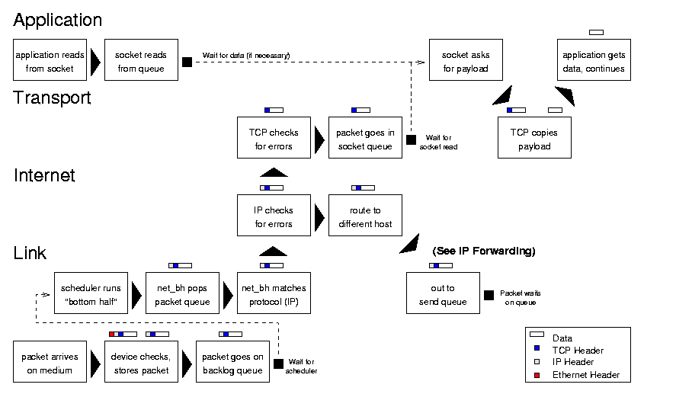
Received Packet Processing
Source = http://www.cs.unh.edu/cnrg/people/gherrin/linux-net.html#tth_sEc6.2

Slide 19
Interrupt Handler
“Top half” responsible to:
  Allocate/get a buffer (sk_buff)
  Copy received data into the buffer
  Initialize a few fields
  Call “bottom half” handler
In reality:
  Systems allocate ring of sk_buffs and give to NIC
  Just “take” the buff from the ring
    No need to allocate (was done before)
    No need to copy data into it (DMA already did it)

Slide 20
SoftIRQs
A hardware IRQ is the hardware interrupt line
  Use to trigger the “top half” handler from IDT
SoftIRQ is the big/complicated software handler
  Or, “bottom half”
How are these implemented in Linux?
  Two canonical ways: SoftIRQ and Tasklet
  More general than just networking

Slide 21
SoftIRQs
Kernel’s view: per-CPU work lists
  Tuples of <function, data>
At the right time, call function(data)
  Right time: Return from exceptions/interrupts/sys. calls
  Each CPU also has a kernel thread ksoftirqd_CPU#
    Processes pending requests
    In case softirq can’t handle them quickly enough

Slide 22
SoftIRQs
Device programmer’s view:
  Only one instance of SoftIRQ will run on a CPU at a time
    Doesn’t need to be reentrant
      If interrupted by HW interrupt, will not be called again
        Guaranteed that invocation will be finished before start of next
  One instance can run on each CPU concurrently
    Must use spinlocks to avoid conflicting on data structures

Slide 23
Tasklets
For the faint of heart (and faint of locking prowess)
Constrained to only run one at a time on any CPU
  Useful for poorly synchronized device drivers
    Those that assume a single CPU in the 90’s
  Downside: All bottom halves are serialized
    Regardless of how many cores you have
    Even if processing for different devices of the same type
      e.g., multiple disks using the same driver

Slide 24
Receive bottom half
For each pending sk_buff:
  Pass a copy to any taps (sniffers)
  Do any MAC-layer processing, like bridging
  Pass a copy to the appropriate protocol handler (e.g., IP)
    Recur on protocol handler until you get to a port number
      Perform some handling transparently (filtering, ACK, retry)
    If good, deliver to associated socket
    If bad, drop

Slide 25
Socket delivery
Once bottom half moves payload into a socket:
  Check to see if task is blocked on input for this socket
    If yes, wake it up corresponding process
Read/recv system calls copy data into application

Slide 26
Socket sending
Send/write system calls copy data into socket
  Allocate sk_buff for data
  Be sure to leave plenty of head and tail room!
System call handles protocol in application’s timeslice
  Receive handling not counted toward app
Last protocol handler enqueues packet for transmit

Slide 27
Receive livelock
Condition when system never makes progress
  Spends all time starting to process new packets
Hard to prioritize other work over interrupts
Better process one packet to completion
  Than to run just the top half on a million

Slide 28
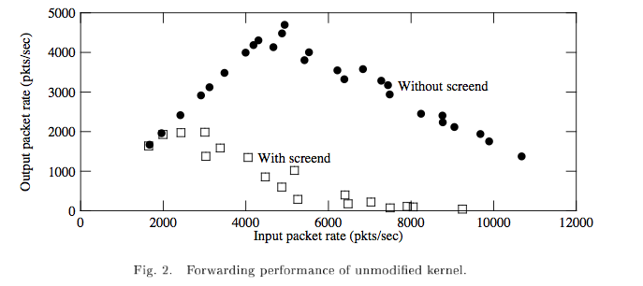
Receive livelock in practice
Ideal
Source: Mogul & Ramakrishnan, ToCS 96

Slide 29
Shedding load
If can’t process all incoming packets
  Must drop some
If going to drop some packets, better do it early!
  Stop taking packets off of the network card
    NIC will drop packets once its buffers get full on its own

Slide 30
Polling Instead of Interrupts
Under heavy load, disable NIC interrupts
Use polling instead
  Ask if there is more work once you’ve done the first batch
Allows packet go through bottom half processing
  And the application, and then get a response back out
  Ensures some progress

Slide 31
Why not poll all the time?
If polling is so great, why bother with interrupts?
Latency
  If incoming traffic is rare, want high-priority
    Latency-sensitive applications get their data ASAP
    Ex.: annoying to wait at ssh prompt after hitting a key

Slide 32
General Insight on Polling
If the expected input rate is low
  Interrupts are better
When expected input rate is above threshold
  Polling is better
Need way to dynamically switch between methods

Slide 33
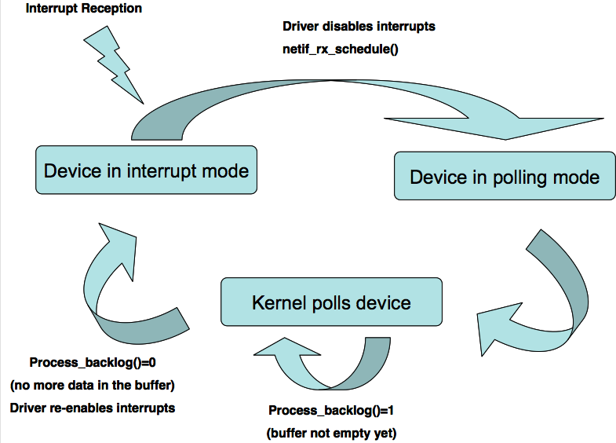
Pictorially
Source: download.intel.com/design/intarch/PAPERS/323704.pdf

Slide 34
Why is this only relevant to networks?
Why don’t disks have this problem?
  Inherently rate limited
If CPU is too busy processing previous disk requests
  It can’t issue more
External CPU can generate all sorts of network inputs

Slide 35
Linux NAPI
“New API”
Drivers provides poll() for low-level receive
  Called in first step of softirq RX function
Top half schedules poll() to do receive as softirq
  Can disable the interrupt under heavy loads
    Use timer interrupt to schedule a poll
  Bonus: Some NICs have a built-in timer
    Can fire an interrupt periodically, only if something to say!
Gives kernel control to throttle network input

Slide 36
Linux NAPI and Legacy Drivers
Slow adoption – drivers need to be rewritten
Backwards compatibility solution:
  Old top half creates sk_buffs and puts them in a queue
  Queue assigned to a fake “backlog” device
  Backlog poll device is scheduled by NAPI softirq
  Interrupts can still be disabled on NIC

Slide 37
NFS

Slide 38
Intuition
Instead of translating VFS requests into disk accesses
  Translate them into remote procedure calls to server
Easy, right?

Slide 39
Challenges
Server can crash or be disconnected
Client can crash or be disconnected
How to coordinate multiple clients on same file?
Security

Slide 40
Disconnection
Machine can crash between writes to the hard drive
  Client can crash between writes to the server
Server must recover if client fails between requests
  Simple protocols (e.g., send block updates) won’t work
    Client disconnects after marking block in use, before referencing it
  When is it safe to reclaim the block?
    What if, 3 months later, the client tries to use the block?

Slide 41
Stateful protocols
Stateful protocols persist state across requests
  Like the example on previous slide
Server Challenges:
  Knowing when a connection has failed (timeout)
  Tracking state that needs to be cleaned up on a failure
Client Challenges:
  If server thinks we failed (timeout)
    Must recreate server state to make progress

Slide 42
Stateless protocol
The (potentially) simpler alternative:
  All necessary state is sent with a single request
  Server implementation much simpler!
Downside:
  May introduce more complicated messages
    And more messages in general

Slide 43
NFS is stateless
Every request sends all needed info
  User credentials (for security checking)
  File identifier and offset
Each request matches VFS operation
  e.g., write, delete, stat

Slide 44
Challenge: Lost request?
Request sent to NFS server, no response received
  Did the message get lost in the network (UDP)?
  Did the server die?
  Is the server slow?
    Don’t want to do things twice
      Bad idea: write data at the end of a file twice
Idea: Make all requests idempotent
  Requests have same effect when executed multiple times
    Ex: write() has an explicit offset, same effect if done 2x

Slide 45
Challenge: Inode reuse
Process A opens file ‘foo’
  Maps to inode 30
Process B unlinks file ‘foo’
  On local system, OS holds reference to the inode
    Blocks belonging to file ‘foo’ not reused
  NFS is stateless, server doesn’t know about open handle
    The file can be deleted and the inode reused
    Next request for inode 30 will go to the wrong file
Idea: Generation numbers
  If inode in NFS is recycled, generation number is incremented
  Client requests include an inode + generation number
    Enables detecting attempts to access an old inode

Slide 46
Challenge: Security
Local UID/GID passed as part of the call
  UIDs must match across systems
  Yellow pages (yp) service; evolved to NIS
  Replaced with LDAP or Active Directory
Root squashing: “root” (UID 0) mapped to “nobody”
  Ineffective security
    Can send any UID in the NFS packet
    With root access on NFS client, “su” to another user to get UID

Slide 47
Challenge: File locking
Must have way to change file without interference
  Get a server-side lock
    What happens if the client dies?
    Lots of options (timeouts, etc), mostly bad
  Punted to a separate, optional locking service
    With ugly hacks and timeouts

Slide 48
Challenge: Removal of open files
Unix allows accessing deleted files if still open
  Reference in in-memory inode prevents cleanup
    Applications expect this behavior
      How to deal with it with NFS?
On client, check if file is open before removing it
  If yes, rename file instead of deleting it
    .nfs* files in modern NFS
  When file is closed, delete temp file
    If client crashes, garbage file is left over ☹

Slide 49
Challenge: Time synchronization
Each CPU’s clock ticks at slightly different rates
  These clocks can drift over time
Tools like ‘make’ use timestamps
  Clock drift can cause programs to misbehave
  make[2]: warning: Clock skew detected.
  Your build may be incomplete.
Systems using NFS must have clocks synchronized
  Usually with external protocol like NTP
    Synchronization depends on unknown communication delay
      Very complex protocol
      Works pretty well in practice

Slide 50
Challenge: Caches and Consistency
Clients A and B have file in their cache
Client A writes to the file
  Data stays in A’s cache
  Eventually flushed to the server
Client B reads the file
  Does B see the old contents or the new file contents?
    Who tells B that the cache is stale?
      Server can tell
        But only after A actually wrote/flushed the data

Slide 51
Consistency/Performance Tradeoff
Performance: cache always, write when convenient
  Other clients can see old data, or make conflicting updates
Consistency: write everything immediately
  And tell everyone who may have it cached
  Much more network traffic, lower performance
  Common case: accessing an unshared file

Slide 52
Close-to-Open Consistency
NFS Model: Flush all writes on a close
When opening file, get latest version on the server
  Copy entire file from server into local cache
  Odd behavior when multiple clients use the same file
    Probably a reasonable compromise
  What if the file is really big?
    How big is “really big”?

Slide 53
NFS Evolution
The simple protocol was version 2
Version 3 (1995):
  64-bit file sizes and offsets (large file support)
  Bundle attributes with other requests to eliminate stat()
  Other optimizations
  Still widely used today

Slide 54
NFS V4 (2000)
Attempts to address many of the problems of v3
  Security (eliminate homogeneous UID assumptions)
  Performance
Becomes a stateful prototocol
pNFS –extensions for parallel distributed accesses
Too advanced for its own good
  Much more complicated then v3
    Slow adoption
  Barely being phased in now
    With hacks that lose some of the features (looks more like v3)

